Slide 1
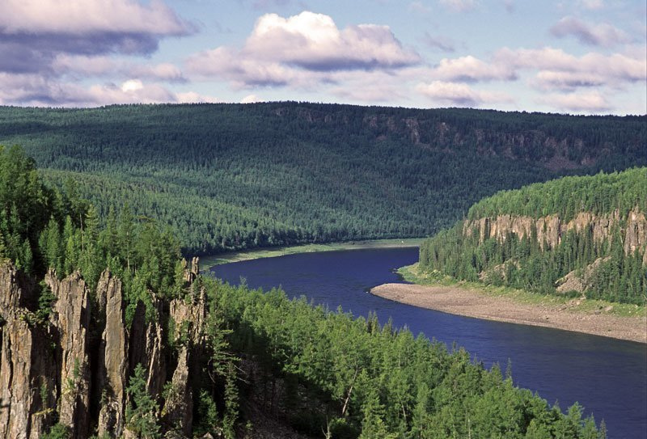
Reconstructing Proto-Yeniseian Laterals and Rhotics
К реконструкции праенисейских латеральных
и ротических согласных
Edward Vajda Эдвард Вайда
(Western Washington University Западный Вашингтонский Университет)
70th S. A. Starostin Jubilee Conference
Moscow, March 24, 2023

Slide 2
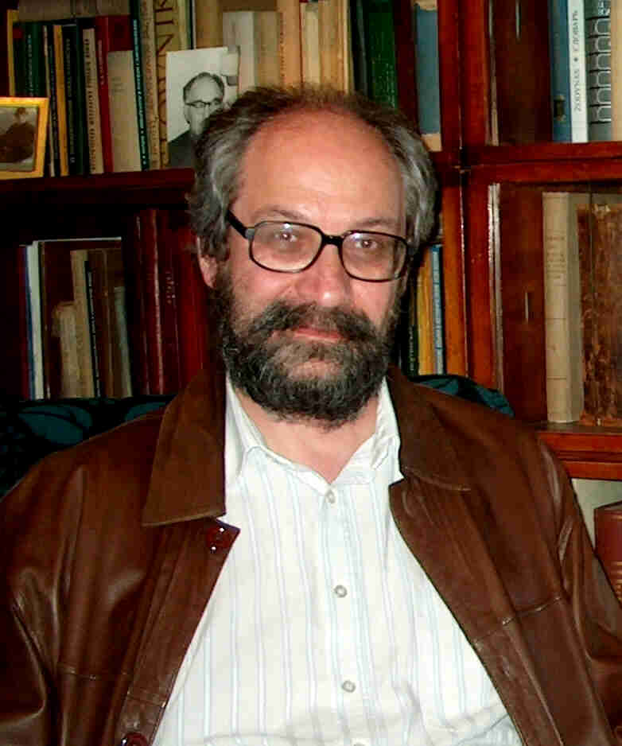
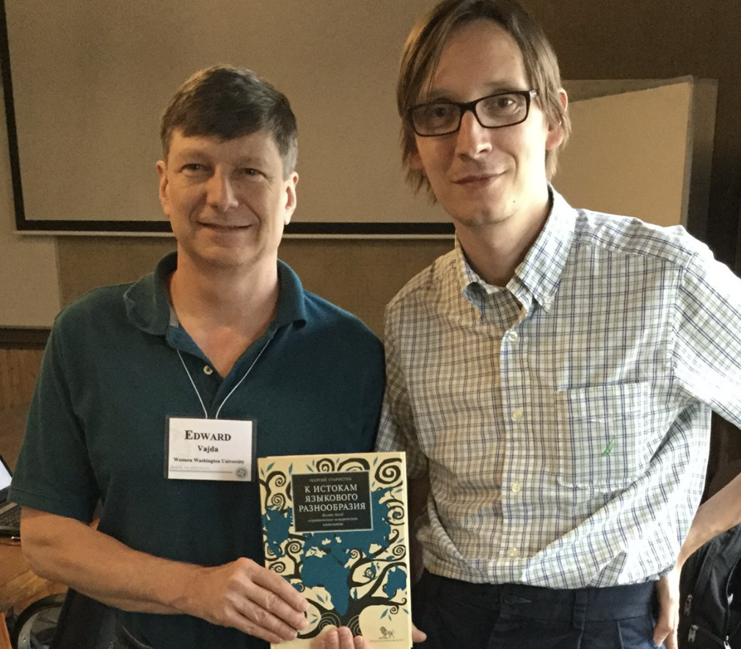
Language Classification
Moscow School
Sergei A. Starostin
(1953 – 2005)
Painstakingly accurate compilations of lexical data
Bold consideration of linguistic classification at increasingly deep time depths
Rigorous reconstructions of individual families (Starling), many representing seminal contributions to their respective fields
George Starostin (son)

Slide 3
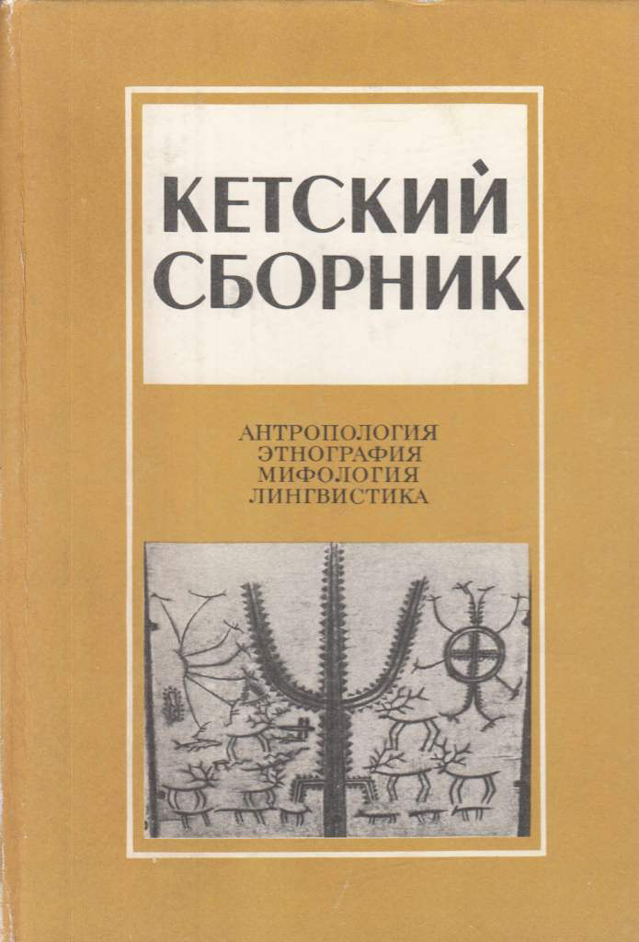
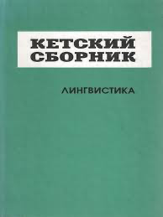
Two key books on Yeniseian studies
First comprehensive reconstruction of the Proto-Yeniseian sound system by S. A. Starostin.
Reconstructed Proto-Yeniseian phonology contained five liquids:
*l *l^{j}
*r₁ *r₂ *r^{j}
This paper reexamines the evidence and reduces the number to 3: *tɬ, *ɬ, *r
1982 г.
1995 г.

Slide 4
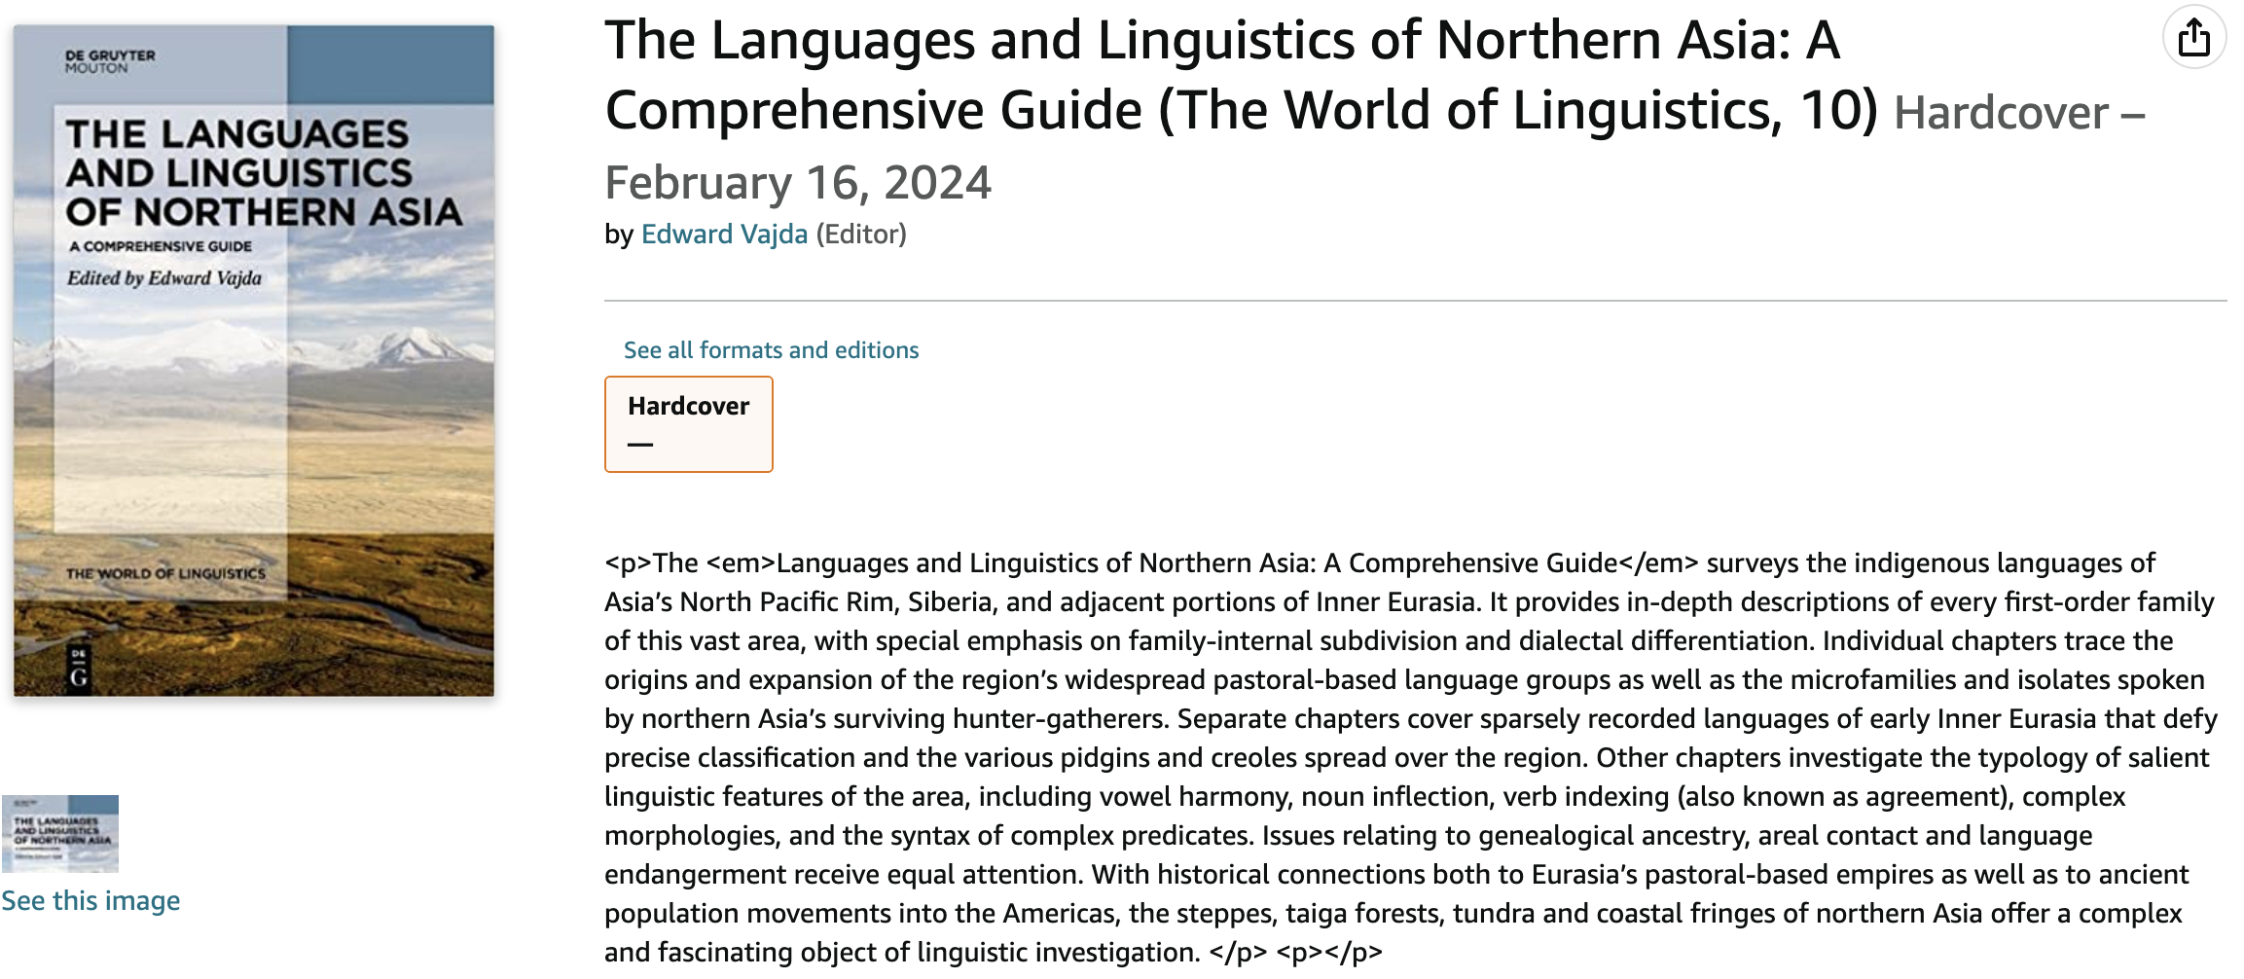
Two sources for the Proto-Yeniseian reconstructions in this presentation:
Vajda, Edward, Etymological Thesaurus of the Yeniseian Languages (work in progress, expected to be appr. 800 pages)
Vajda, Edward, “The Yeniseian Language Family”, 60-page chapter, to be published in the following volume:

Slide 5
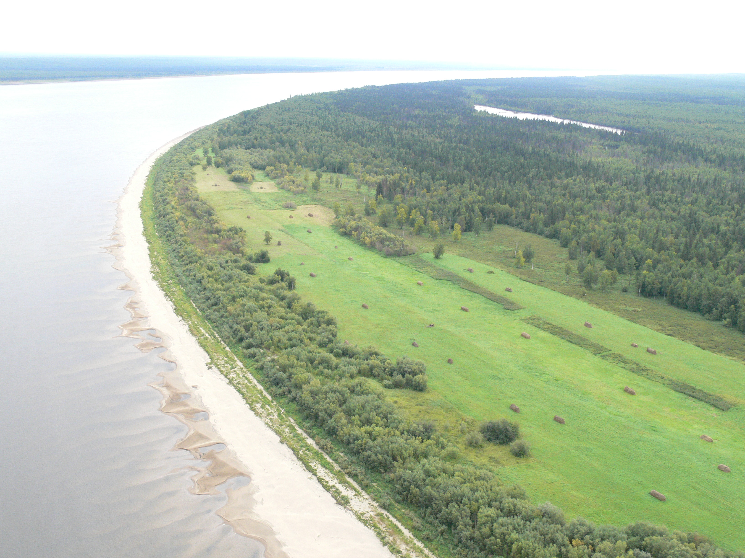
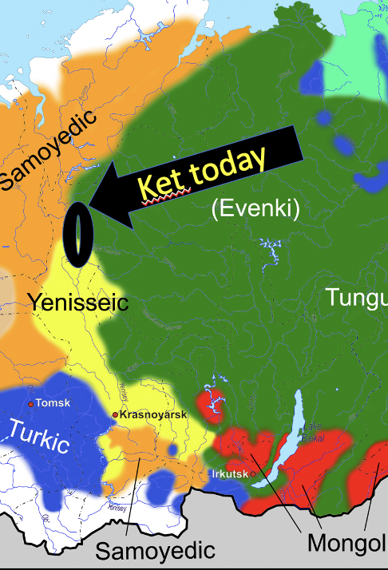
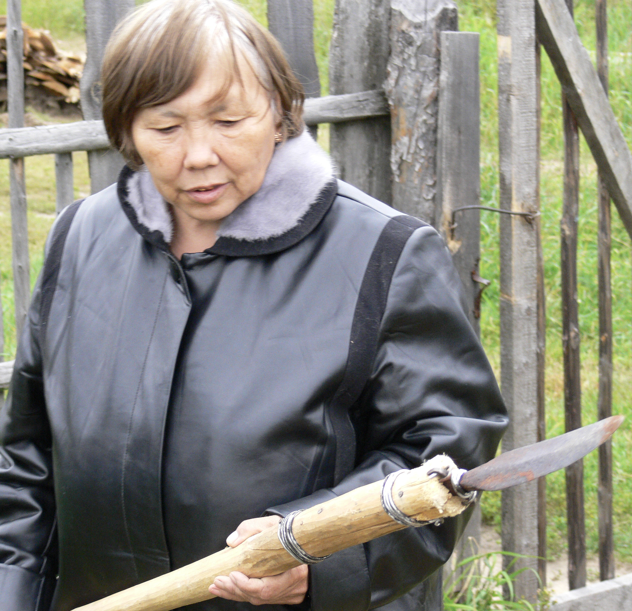
Ket ethnicity and language in Central Siberia
Ket is the only surviving member of the Yeniseian (or Yeniseic, Yenisseic) family
Population today: about 1400, including many with partial Ket ancestry
All Kets speak Russian; perhaps fewer than 20 fluent speakers remain
,
Yenisei River
Tengdalang (Valentina Romanenkova)
– one of the last fluent Ket speakers

Slide 6
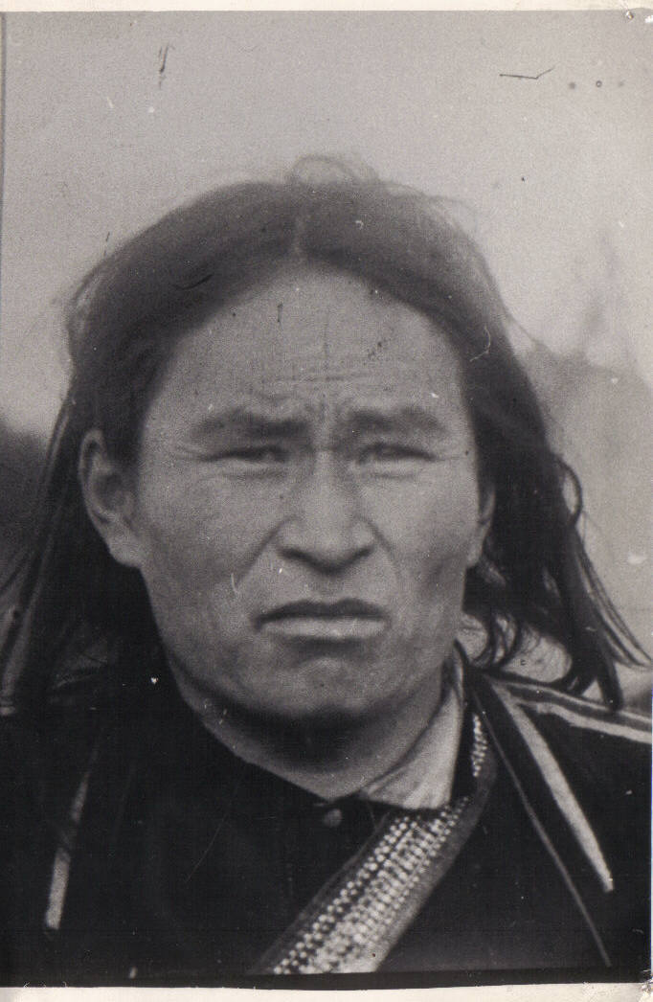
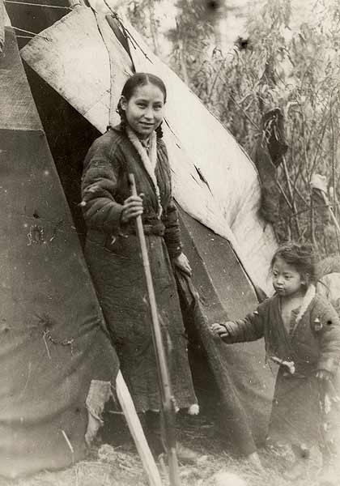
The Ket people were Siberia’s last hunter-gatherers
Their language is not genealogically related to other Siberian families
,
Photo from Russian Academy of Science 1906 Anuchin Expedition, the first scientific study of the Kets
1927 – 1928
Photo by Hans Findeisen (Berlin Museum),
the last foreign scholar
to visit the Kets
during the 20th century.

Slide 7
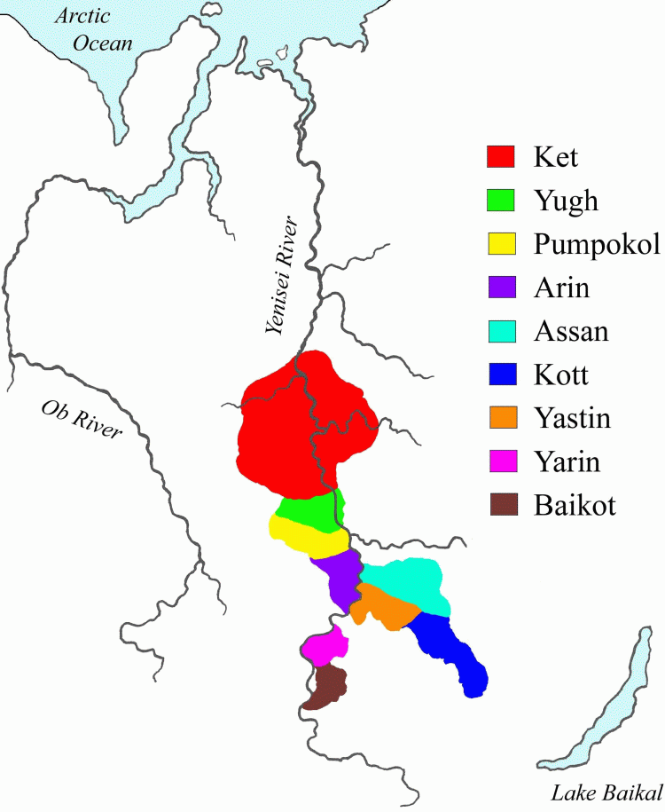
Yeniseian language family
4 primary branches: Ket-Yugh, Kott-Assan, Arin, Pumpokol
Ket and Kott are crucial for reconstructing Proto-Yeniseian
Arin, Pumpokol poorly attested
Kets today
Yeniseian-speaking groups attested in 17^{c} Tsarist yasak
(fur tax) records
Probable Proto-Yeniseian homeland

Slide 8
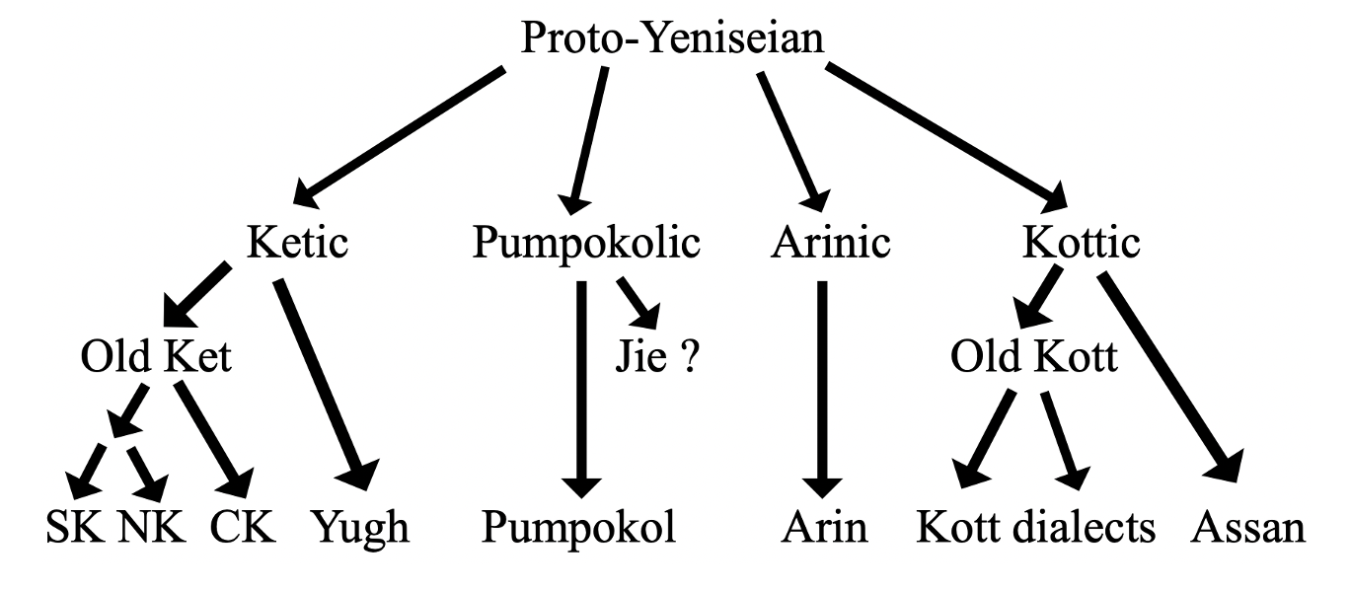
Internal diversification of the Yeniseian family
Four primary branches
Ketic and Kottic are the most important in terms of available data
Arin and Pumpokol data are generally too sparse to do more than reinforce what can be seen from comparing the other two branches.
Ket dialects collapsed all laterals and rhotics into a single phoneme
Yugh retains three liquid phonemes: /l/, /l^{j}/, /r/
Comparing Yugh with Kott is key for reconstructing PY laterals and rhotics

Slide 9
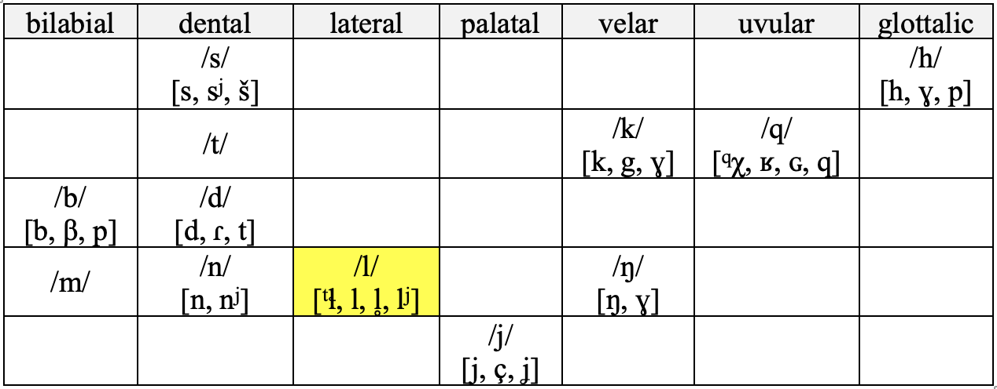
The modern Ket consonant inventory (all dialects)
Three allophones of modern Ket phoneme /l/
[ ^{t}ɬ ] – word-initial pre-affricated voiceless lateral
[ l ~ l^{j} ] – voiced lateral liquid medially and sometimes word-finally; often semi-palatalized, but in free variation, not forming minimal pairs
[ l̥ ] – voiceless lateral liquid generally found only at the end of falling tone words

Slide 10
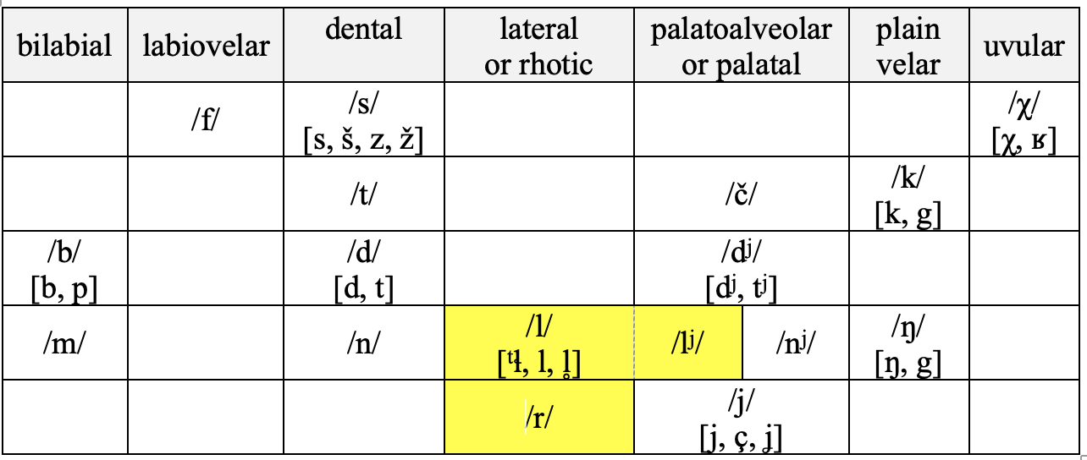
The 20th century Yugh consonant inventory
Yugh /r/ derives from a merger of PY rhotic *r and lateral *l, probably pronounced [ɬ]
Yugh /l/ is a reflex of PY lateral *tɬ
The uncommon Yugh palatal /l^{j}/ is innovative, derived from coalescence of PY *r or *l with a velar segment

Slide 11
Origin of Yugh palatalized phoneme
/l^{j}/
*aspɯlaŋ, PK ‘clouds’ > Ket aspulaŋ, Yugh asfɯliŋ ~ asfɯːl^{j} id.
> asfɯːl^{j}, Yugh (adj) ‘cloudy’, ‘nebulous’ < PK *aspɯl ‘cloud’ + *Vŋ^{w} (adj suff., reduced to vowel length, softness of /l^{j}/)
*dulken, PK ‘stem’, ‘handle’ < *dul ‘stalk’ + *ken ‘wood’ > SK dūˑl (pl dulaŋ), NK dūl^{j}i (pl dūˑl^{j}eŋ), Yugh dūˑl^{j} id. (pl dūˑl^{j}iŋɯn [-iŋ < *ken ‘wood’])
*xurVŋ^{w}, PY (adj) ‘wet’ < *xur ‘rain’, ‘moisture’ + *Vŋʷ (adj) > Ket ūˑl ~ uleŋ, Yugh ūˑl^{j} ‘wet’
Remember that all laterals and rhotics merged to /l/ in modern Ket.

Slide 12
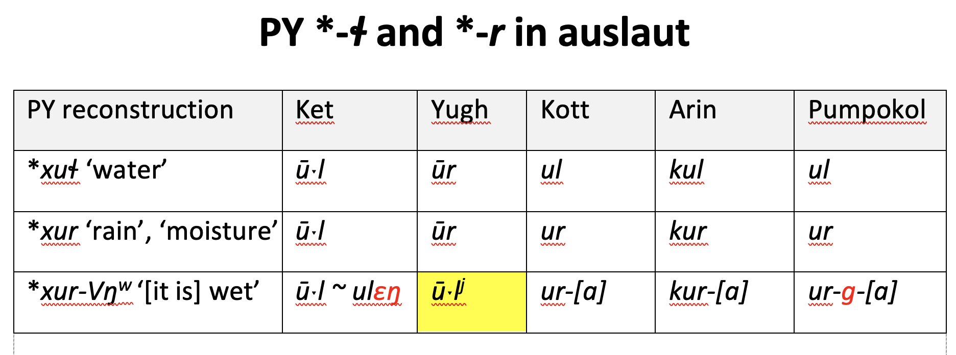
No evidence that native PY *r appeared word initially, except in a few clippings: Assan (he)rajali ~ grajali ‘food’, (he)rajbatovač ‘table’ (cf. Kott herajaŋ ‘eating’)
Sonorant consonants are disfavored word-initially in PY (and still in Modern Ket)
However, word-initial laterals are common in Ket and can be reconstructed for PY, as well, suggesting they were obstruents rather than sonorants.

Slide 13
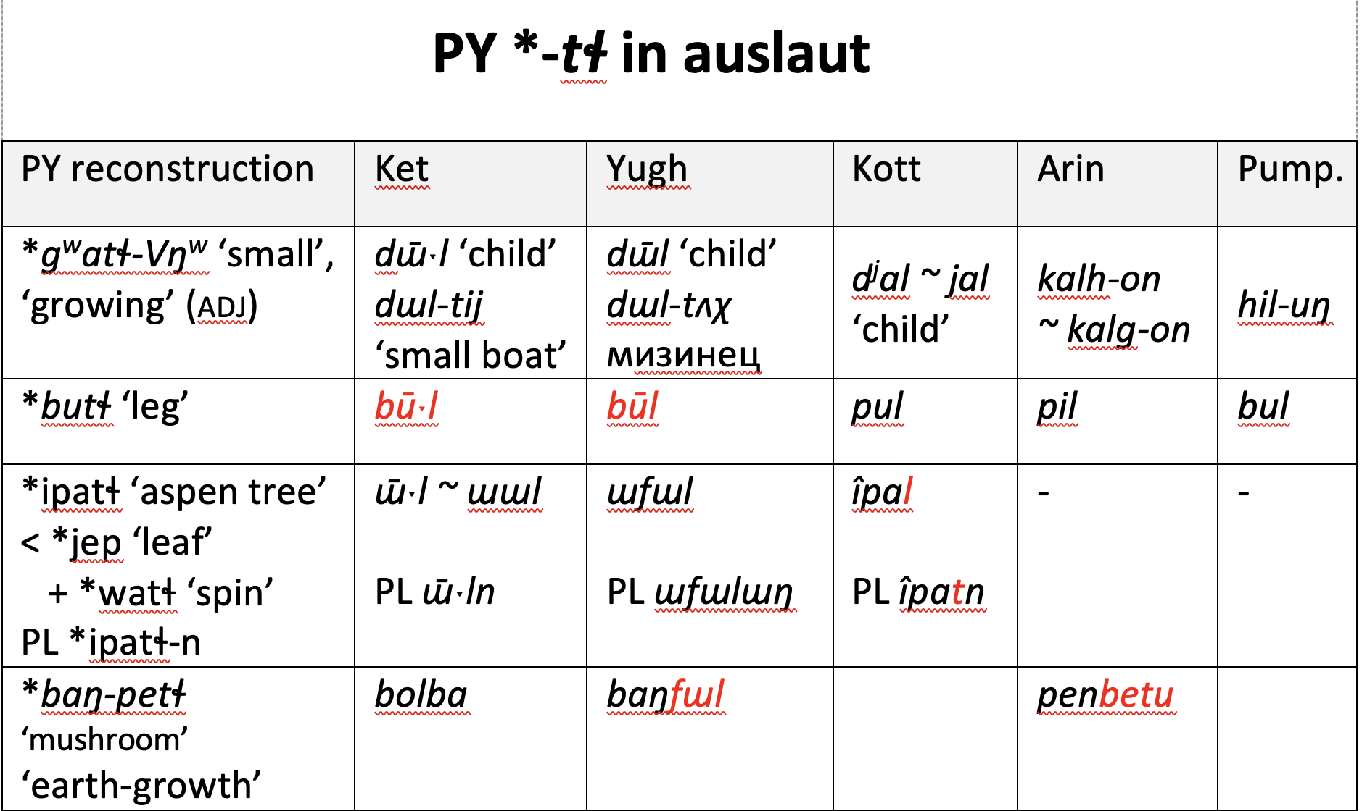
Reductions of complex auslaut articulation yielded length in Ket/Yugh but not in Kott
Sporadic t ~ l alternations

Slide 14
Evolution of auslaut laterals and rhotics in the Ketic branch
Yugh /r/ cognate with Kottic, Arin, Pumpokol /r/ supports reconstructing PY *r
Yugh /r/ cognate with Kottic, Arin, Pumpokol /l/ supports reconstructing PY *ɬ
Yugh /l/ cognate with Kottic, Arin, Pumpokol /l/ supports reconstructing PY *tɬ
Additional processes in the other daughter branches?
Arin sporadically (?) rhotacized auslaut PY *tɬ and *ɬ, as in the compound proroŋ ‘leggings’ (cf. Arin pil ‘leg’, also Yugh o’l ‘covering
’
Kott čogár ‘snow sled’, but Yugh soul, Arin šal, Pump. zell ~cel id.

Slide 15
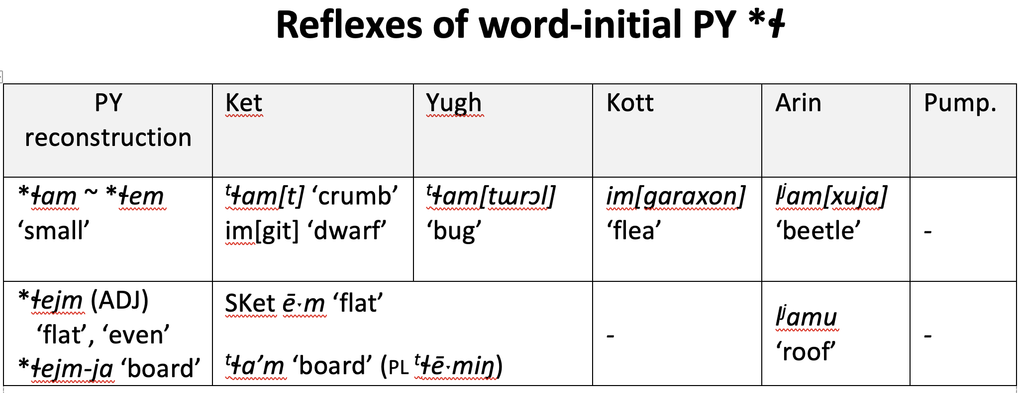
Word initial *ɬ was normally retained as a lateral only before back vowels.
Before front vowels, it became [j] and later elided, raising and/or lengthening the following front vowel.
This explains why virtually all Ket words with anlaut [^{t}ɬ] are followed by back rather than front vowels.

Slide 16
Irregularities in the development of PY anlaut *ɬ
Alternations between lateral + back vowel and zero onset + front vowel with no clear conditioning factor.
*ɬepja, PY ‘snow shovel’ < *ɬap ‘flat object’ + *ja (nmlz) > Ket eˀp (pl eːŋ), Yugh eˀp (pl efɯŋ) ‘snow shovel (large flat board with handle)’; ? ≈ Kott _{(C)} îp (pl iŋ ~ eŋ) ‘ski’
> d^{j}âfol ~ d^{j}âfal ~ d^{j}âful, Kott _{(C)} ‘board’ < metathesis of nmlz d^{j}â (< *ja) + *lep ‘flat piece of wood’); ≃ SK laˀm, NK lēˑm ‘board’, Ket īˑm ‘flat’
≃ kul^{j}ep ~ kul^{j}êp, Kott _{(C)} ‘shovel’ (pl kul^{j}êpaŋ) < ku ‘digging’ (? ≈ PK *qɯd^{j} ‘dig, poke, scrape’) + *lepja ‘board’
*laˀm, PK ‘board’ < *ɬēˑm ‘flat’, ‘even’, ‘smooth’ > SK laˀm (pl lēˑmɯŋ) ‘board’, ‘table’, CK, NK lēˑm (pl lemɯŋ) id.; Yugh laˀm (pl lemɯŋ) ‘board’; Ket _{(Ad, VW)} l^{j}am ‘floor’; also Ket laˀm (pl lamen), Yugh lām ~ laˀm (pl lamɯn) ‘side’
≃ l^{j}amu, Arin _{(H)} ‘roof’ (probably pl form of ‘board’)

Slide 17
**ɬabja, PY ‘tongue’ < *ɬaw ‘extend’ + *ja (nmlz)
*alap(e), OArin ‘tongue’ > Arin _{(M, W, VW, Kl)} álap, _{(H)} elep id.
*alûp, OKott ‘tongue’ > Kott _{(H)} _{(M, W, VW, Kl)} alup, _{(C)} alûp ~ alup (pl alupaŋ ~ alupan), Assan _{(M, W, Kl)} alûp, _{(VW)} alup id.
> alûpfun ~ alûppun, Kott _{(C)} ‘mute’, Yugh ejfan id. < *lʌb ~ *ēj ‘tongue’ + *pʌn ‘without’
≃ *lab-, PK (initial combining form) > *labt^{j}aqŋ ‘biting’, *lapt^{j}edej ‘chomp (while eating)’
? *ēˑje, PK ‘tongue’ > *Ket ēˑj (pl SK èj, NK èːji, CK èːj ~ èːjʌ), Yugh ēj (pl eː^{ħ}j ~ eŋn^{j}iŋ), Ket _{(M, W, VW, Kl)} ej, _{(Ad 1)} ii, _{(Ad 2)} ij, Yugh _{(M)} ej, Yugh_{P} _{(W, VW)} aj id.
? ≃ iilɨgɨl, Pump. _{(Kl)} ‘tongue’ [? two synonyms pronounced in succession: native Yen. iilɨ ‘tongue’ and loanword kɨl ‘tongue’ ⇽ Mong. *kajl ‘tongue’ or Uralic *käle ‘tongue’]

Slide 18
Irregular long-distance assimilation or prefix *al ~ *il ?
*ɬaɢe, PY ‘star’ < *ɬa ‘extend (rays), scintillate’ + *ɢe (nmlz)
*alaga, OKott ‘star’ [regular prothetic a- anlaut lateral, ǂ T 1982 who claims al- is pref.] > Kott _{(C)} alaga ~ alak ~ aláx (pl alagan ~ alakŋ, poss alagei), Assan _{(M, W, VW, Kl)} alák ‘star’; ≃ Kott _{(M, W, VW, Kl)} alagán, _{(H)} alakan, Koibal _{(Mes, P)} alagan ‘star[s]’ [pl -n]
Arin _{(M, W, Kl)} ílqoj, _{(VW)} il^{j}koj, _{(H)} ilxok ‘star’
Proto-Ket-Yugh (= Proto-Ketic) *qoː^{ħ}qe ‘star’ > NK qoˀ (pl qoːn), SK qòʁ (pl qoːn), CK qòːʁe (pl qoːn), Yugh χoː^{ħ}χ (pl χoχɯn), Ket _{(M)} kóágo, _{(W)} kaágo, _{(VW, Kl)} kóógo, _{(Ad)} ko, _{(Kl)} xogen [pl -en], EKet _{(Mes)} xogh, Yugh _{(M)} xogen [pl -n] ‘star’
Pumpokol kaken ‘stars’

Slide 19
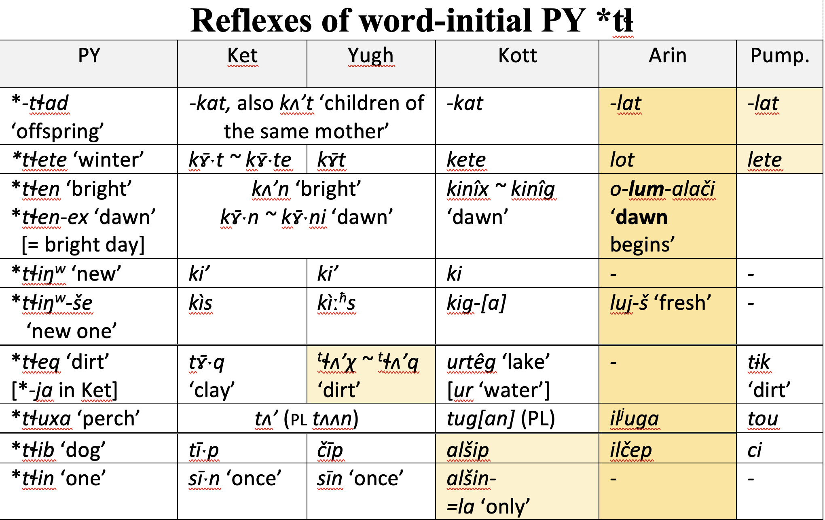
Lateral quality retained most consistently in Arin
Fate of word-initial PY *tɬ in the other branches dictated by syllable rhyme (front vs. back vowel, coda place of articulation)

Slide 20
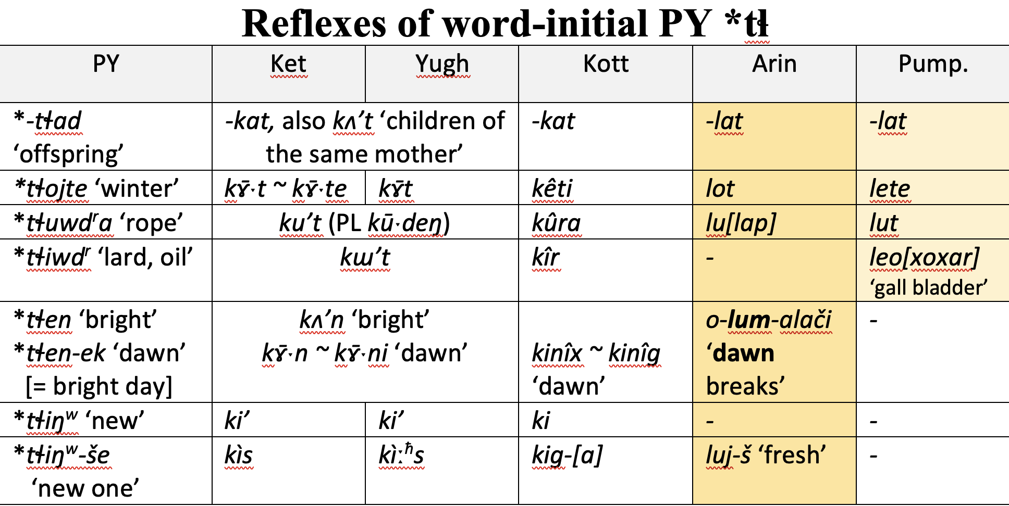
Lateral quality retained most consistently in Arin, and Pumpokol.
Ketic and Kottic underwent the change of PY anlaut *tɬ to voiced *g, later devoiced to *k. This occurred at different times in each branch.
Proto-Ketic *g rounded an adjacent *a to /o/ before devoicing, as in Ket ko’t ‘rump’ (vs. Kott kar ‘vagina’) both from PY *tɬad^{r} ‘rump’
Ket determiner *k that rounds preceding agreement marker < *g

Slide 21
More possible evidence of word-initial PY *tɬ ?
Previous slide: Word-initial PY *tɬ most often became Proto-Ketic *g, which devoiced to /k/ in Modern Ket and Yugh.
(Above) Word-initial PY *tɬ > *t (less often *ɬ) in syllables with velar or uvular obstruent coda.
(Below) Word-initial PY *tɬ > *č before *I in syllable without a velar coda.
this root for Kott/Assan ‘one’ appears only in compounds meaning ‘one hundred’

Slide 22
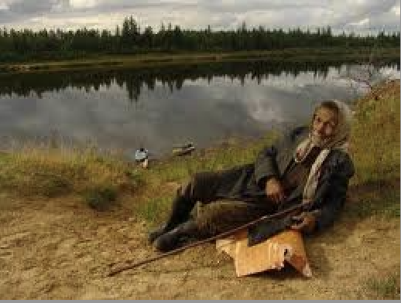
Conclusions
PY had two lateral phonemes: *tɬ and *ɬ.
PY Laterals were obstruents, could appear word-initially.
PY had only one rhotic phoneme *r - a sonorant that normally appeared only medially or finally, like other PY sonorant consonants.
Processes of vowel ablaut, length, and tone must be considered when reconstructing PY consonants.
These results might add
to S. A. Starostin’s work on
reconstructing lateral affricates
at deeper levels of relationship
between language families.
Спасибо!

