Slide 1
Considering the classification of some East Slavic lects with the automatic search
of linguistic SNP markers
Ilia Afanasev

Slide 2
A lifetime of coevolution
Developed and emerged as a discipline simultaneously in the 19th century
Some important concepts in comparative linguistics are explicitly inspired by evolutionary biology (Schleicher, 1863)
With appearance of computational methods in evolutionary biology, comparative linguistics followed the way, forming the discipline of computational historical linguistics (Jäger, 2019)

Slide 3
Common challenges and common solutions
Nowadays, disciplines demonstrate the convergent evolution (Starostin, 2022)
Language is no longer a living system, but an evolvable one (Ladoukakis et al., 2022)
Prediction of evolution direction becomes more important for evolutionary biology and comparative linguistics (Hejnol and Martindale, 2008; Sims-Williams, 2022; Marlo et al., 2022)
Statistical methods are important for both the disciplines (Flego, 2022; Engelman, 2023)

Slide 4
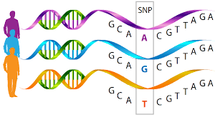
Single nucleotide polymorphism
In genetics, a variation in single position in a DNA sequence among the individuals
In linguistics, there is no (yet) analogue for DNA
(Rama et al., 2014: 3) hypothesise it to be a sequence of characters (??)
Thus, currently it is at least very complicated to find linguistic SNPs (ling-SNPs), changes in the language inner structure
Language change, however, definitely happens, and there are events that signal about change in a sequence of characters that define the language features
These events leave visible traces in the units of the language

Slide 5
Linguistic single nucleotide polymorphism (ling-SNP) markers
Entities, directly observed in the empirical data (word list or corpus), that contain the traces of the change in a language
Do not necessarily map to particular units of language
Examples include:
Stress change
Morphological change
Lexical swap

Slide 6
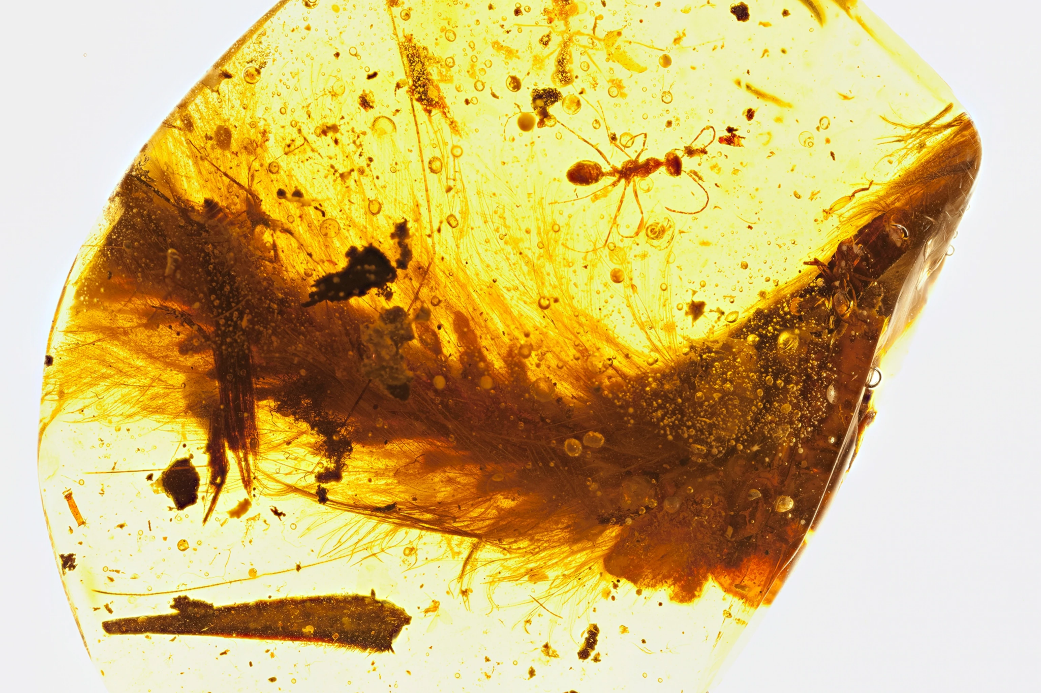
Swadesh list: a chronicle of amber
There are spans of text, where one is more likely to find ling-SNP markers
Swadesh list items are an example of such a span

Slide 7
Example: East Slavic ‘mother’
A member of 40-item Swadesh list (Holman et al., 2008)
Standard Belarusian: маці, standard Russian: мать, Khislavichi: маць
SNP marker: ці/ть/ць
Possible language structure changes: vocalisation of a reduced front vowel (Khislavichi, Russian - Belarusian), palatalisation of a dental consonant before front vowel (Khislavichi, Belarusian - Russian)
Levenshtein distances:
Khislavichi - Russian: 1.0, normalised: 0.25
Khislavichi - Belarusian: 1.0, normalised: 0.25
Belarusian - Russian: 2.0, normalised: 0.5

Slide 8
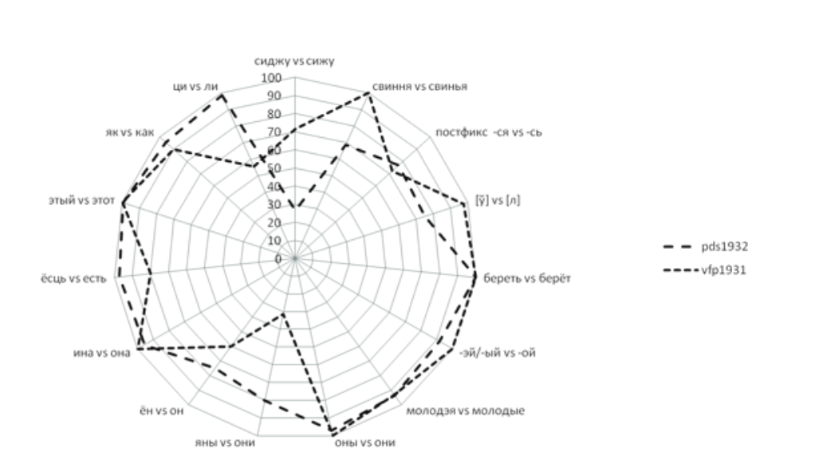
Case study: Khislavichi lects on the East Slavic tree
The position of Khislavichi lects between the Russian and Belarusian lects is controversial (Karski, 1903; Durnovo et al., 1915; Zakharova and Orlova, 2004; Ryko and Spiricheva, 2022)
Traditional comparison by Swadesh list is not sensitive enough, as the lects are closely related (Nerbonne et al., 1999)
Figure from (Ryko and Spiricheva, 2022)

Slide 9
Method
Extraction of linguistic SNP markers
Distance measurement: Levenshtein distance normalised divided (LDND) over the spans of texts that contain l-SNP markers
Classification: rooted tree over distance-tree matrix

Slide 10
Automatic search of ling-SNP markers
There are no ready word lists for Khislavichi, and there is a corpus of Khislavichi texts (approximately 100 000 tokens)
There are ready word lists for Slavic languages, and big corpora for Slavic languages
Solution:
automatic extraction of a particular type of lexical items (i. e., Swadesh list items) that may contain ling-SNP markers from Khislavichi corpus by the model trained on the various Slavic languages
currently, manual check and manual extraction of ling-SNP markers (automatic extraction is not yet possible)

Slide 11
Automatic search for Swadesh list items: methods
Statistical methods
Hidden Markov Model (HMM)
Conditional Random Fields (CRF)
Neural networks
DistilBERT for Named Entity Recognition (DistilBERT-NER)
VERNet (for Grammatical Error Detection/Correction)
Data augmentation
Token 3-grams

Slide 12
Training data
Dataset | Language | Script | Size
CLTT | Czech | Latin | 36 000
SET | Croatian | Latin | 199 000
Belarusian-HSE | Belarusian | Cyrillic | 305 000
Taiga | Russian | Cyrillic | 197 000

Slide 13
Performance on the training dataset evaluation part
Model | Precision | Recall | F1-score
HMM | 0.64 | 0.99 | 0.77
HMM-augmented | 0.64 | 0.99 | 0.78
CRF | 1 | 0.87 | 0.93
CRF-augmented | 0.99 | 1 | 0.99
DistilBERT-NER | 0.23 | 0.66 | 0.34
DistilBERT-NER-augmented | 0.85 | 0.11 | 0.2

Slide 14
Tokens found in Khislavichi by CRF-augmented
Type | Swadesh list items | Non-Swadesh lexical items that may contain ling-SNP markers | Errors
Tokens | цябе ‘you-SG.GEN’, людзя́м ‘people-PL.DAT’, пришоł ‘come-PAST.SG.M’, ноччу ‘night-SG.INS’, лисця ‘leaf-PL.NOM’, hарах ‘mountain-PL.LOC’, дзярэўях ‘tree-PL.LOC’, и́мя ‘name-SG.NOM’ | фатаhрафираваць ‘take_a_picture-INF’, вот ‘here’ | маць ‘mother-SG.NOM’, hлаза ‘eye-PL.NOM’ inter alia

Slide 15
Orthographic normalisation
Getting Khislavichi tokens closer to their actual form: ночью > ноччу ‘night-SG.INS’, тебя > цябе ‘you-SG.GEN’
Adding graphemes to better depict unique Khislavichi sounds: полный > поłный ‘full-SG.NOM.M’
Unification of akanje manifestation: гора > гара ‘mountain-SG.NOM’ (Russian)
Differentiation of voiced velar fricative/velar plosive: гара > hara ‘mountain-SG.NOM’ (Belarusian)
Putting accents where necessary: iмя > имя́ ‘name-SG.NOM’ (Belarusian)
Unification of different graphical manifestations of the same sound: лісцця > лисцця ‘leaf-PL.NOM’ (Belarusian)

Slide 16
Detected l-SNP markers (Khislavichi/Russian/Belarusian)
Phonetic segmental: оłн/олн/оўн
Phonetic suprasegmental: юдзя́м/ю́дям/юдзя́м
Morphological segmental: аhрафирав/аграфирав/аhрафав
Morphological suprasegmental: дзяревья/деревья/дрэвы
Lexical swap: видзиць/видит/бачыць

Slide 17
Classification basis: triangular matrix of pairwise LDND
Lect | Belarusian | Russian | Khislavichi
Belarusian | 0 | # | #
Russian | 0.5 | 0 | #
Khislavichi | 0.25 | 0.33 | 0

Slide 18
Classification results

Slide 19
Current achievements and desired enhancements
Ling-SNP markers show different types of language variation, from phonetic to lexical, while rely on the verifiably efficient for the genetic classification Swadesh list items
Non-Swadesh list items found by model provide additional insights into the differences between lects
Hyper-sensitivity of LDND is helpful for the East Slavic material, problematic for traditional lexicostatistics methods (Starostin, 1989)
A very special place of Khislavichi lects in the East Slavic system is shown
Low recall for Swadesh list items require new methods of automatic ling-SNP markers search
LDND is hyper-sensitive, it is not scalable for the deeper classification (Prokić and Moran, 2013) - this requires other methods
UPGMA/distance-tree matrix is significantly less informative in comparison to current computational phylogenetic algorithms, such as Naive Bayes, which are to be implemented
Comparing standard and territorial varieties does not seem exactly fair

Slide 20
Further research
Quest for the new automatic ling-SNP markers search and extraction methods
Systemic investigation of Khislavichi/Russian/Belarusian Swadesh and basic vocabulary lists
Search for other sources of ling-SNP markers
Including the material of the other East Slavic lects for triangulation/outgroup comparison
Search for new classification and distance measurement methods
Tests on the other material and thorough discussion of a method are required

Slide 21
Thank you!

Slide 22
References
Nikolaj N. Durnovo, Nikolaj N. Sokolov, and Dmitrij N. Ushakov. 1915. Opyt dialektologicheskoj karty russkogo jazyka v Evrope s prilozheniem Ocherka russkoj dialektologii.Sinodal’naja tipografija,Moscow.
Russell K. Engelman. A Devonian Fish Tale: A New Method of Body Length Estimation Suggests Much Smaller Sizes for Dunkleosteus terrelli (Placodermi: Arthrodira). Diversity, 2023; 15 (3): 318 DOI: 10.3390/d15030318
Flego, S. (2022). The Emergence of Vowel Quality Mutation in Germanic and Dinka-Nuer: Modeling the Role of Information-Theoretic Factors Using Agent-Based Simulation. Indiana University
Hejnol, A.; Martindale, M.Q. (2008). "Acoel development supports a simple planula-like urbilaterian". Philosophical Transactions of the Royal Society of London B. 363 (1496): 1493–1501. doi:10.1098/rstb.2007.2239
Holman, E., Wichmann, S., Brown, C., Velupillai, V., Müller, A., Bakker, D. Explorations in automated language classification. Folia Linguistica, v.42, 331-354 (2008).
Jäger, Gerhard. "Computational historical linguistics" Theoretical Linguistics, vol. 45, no. 3-4, 2019, pp. 151-182. https://doi.org/10.1515/tl-2019-0011
Yefim F. Karskij. 1903. Belorusy. Vol. I. Vvedenie v izuchenie jazyka i narodnoj slovesnosti. Warsaw.
Ladoukakis, M., Michelioudakis, D., Anagnostopoulou, E. Toward an evolutionary framework for language variation and change // BioEssays, vol. 44, pp. 210 – 216.
Michael R. Marlo, Rebecca Grollemund, Thanh Nguyen, Erik Platner, Sarah Pribe, Alexa Thein. A phylogenetic classification of Luyia language varieties // Sibanda, Galen, Ngonyani, Deo, Choti, Jonathan & Biersteker, Ann (eds.). 2022. Descriptive and theoretical approaches to African linguistics: Selected papers from the 49th Annual Conference on African Linguistics. (Contemporary African Linguistics 6). Berlin: Language Science Press. DOI: 10.5281/zenodo.6358613
Prokić, J., Moran, S. Black box approaches to genealogical classification and their shortcomings. 2013. In: Borin, L., Saxena, A. (eds.) Approaches to Measuring Linguistic Differences (Trends in Linguistics. Studies and Monographs 265. Walter De Gruyter GmbH, Boston/Berlin, 2013.
Rama, Taraka, Kolachina, Sudheer, Bai B, Lakshmi (2014). Quantitative methods for Phylogenetic Inference in Historical Linguistics: an experimental case study of South Central Dravidian // CoRR, arXiv, abs/1401.0708.
Anastasiia Ryko and Margarita V. Spiricheva. 2022. The degree of preservation of dialectal features in different generations (khislavichi district of the smolensk region). RSUH/RGGU Bulletin. “Literary Theory. Linguistics. Cultural Studies” Series, (5):121–141.
Schleicher, A. Die Darwinsche Theorie und die Sprachwissenschaft – offenes Sendschreiben an Herrn Dr. Ernst Haeckel. Weimar, H. Boehlau (1863).
Sims-Williams, H. (2022). Token frequency as a determinant of morphological change. Journal of Linguistics, 58(3), 571-607. doi:10.1017/S0022226721000438
Starostin, G. The value of “triangulation” in determining phylogenetic relationship: on the areal and genetic connections of the Bertha languages //Language in Africa, 3(2), pp. 352–367. 2022.
Starostin, S. A. Sravnitel'no-istoricheskoe yazykoznanie i leksikostatistika // Lingvisticheskaya rekonstrukciya i drevnejshaya istoriya Vostoka. Chast' 1. 1989. – S. 407 – 447.
Kapitolina F. Zaharova and Varvara G. Orlova. 2004. Dialektnoe chlenenie russkogo yazyka. URSS, Moscow.

